Slide 1
EBS Snapshot (Cost) Optimization

Slide 2
Problem statement
The project aims to optimize cloud storage costs by identifying and deleting stale EBS snapshots in an AWS environment. It will automate the process of detecting snapshots associated with unattached volumes (not in use by any active EC2 instances) and remove them, reducing unnecessary storage expenses while maintaining data efficiency.

Slide 3
AWS Services Used:
AWS Lambda - is a serverless compute service that lets you run code in response to events without managing servers. It automatically scales and handles execution, charging only for the compute time used. Lambda integrates with various AWS services to build scalable, event-driven applications.
AWS EC2 (Elastic Compute Cloud) - provides resizable compute capacity in the cloud, allowing users to run virtual machines (instances) with flexible configurations. It enables easy scaling of compute resources to meet application demands, offering a cost-effective and scalable solution for a wide range of workloads.

Slide 4
Scope of this project
Lambda function to identify stale snapshots
Delete stale snapshots
Automation of Snapshot cleanup
Logging and Reporting

Slide 5
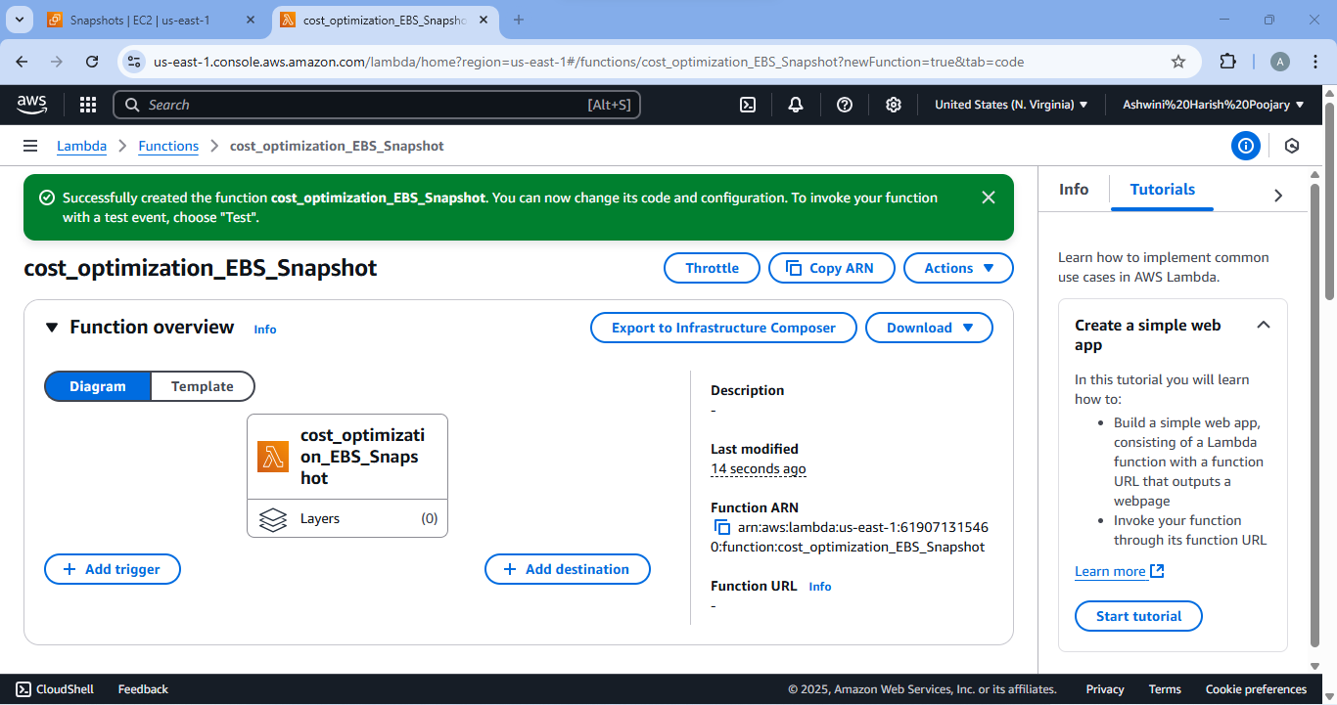
Successful Creation of Lambda Function

Slide 6
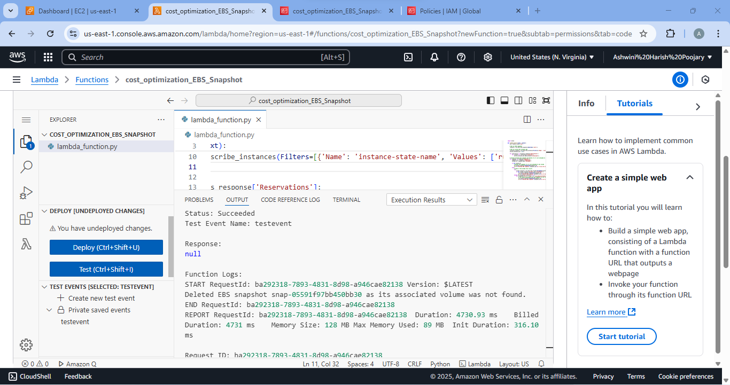
Deleted Snapshot which was not associated to any volume or EC2 instances.

Slide 7

Deleted Snapshot which was taken from volume and are not associated with any EC2 instances.

Slide 8
Thank You
Project by Ashwini Harish Poojary

